Slide 1
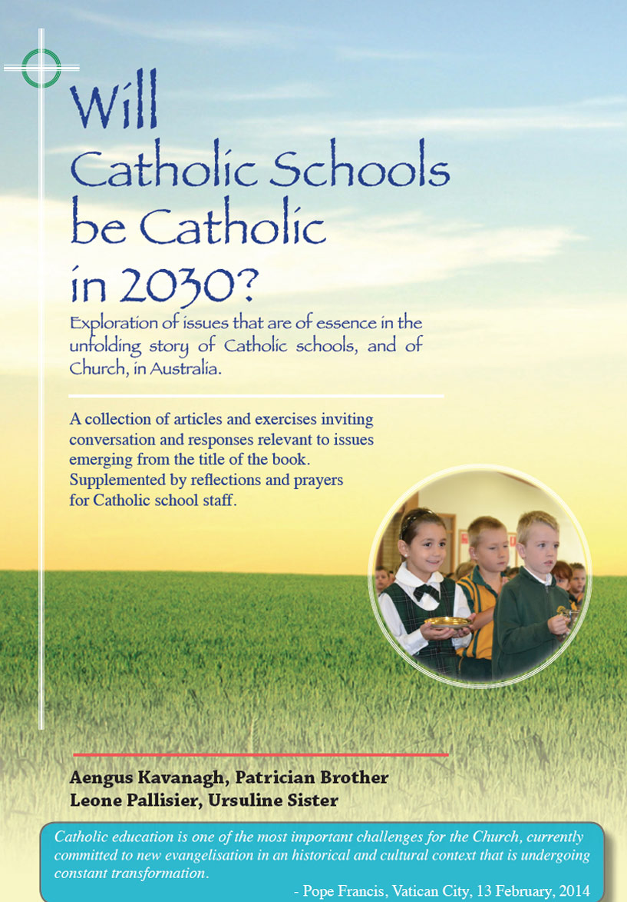
Relationships
And Sexuality
For Teenagers
113-119

Slide 2
Relationships and Sexuality for Teenagers
Themes
Pages 113-119

Slide 3
Many Catholic teenagers become alienated from their faith because of their perception of a gap between the church’s teaching on sexual morality and their own lived experience.
In secondary schools especially, it can happen that responsibility for relevant and appropriate education in sexuality and relationships is unclear unless there is close collaboration in the implementation of those strands of the Personal Development Health and Physical Education (PDHPE) and Religious Education curricula. In the public forum sex education is often erroneously understood as the mere transmission of information without any reference to guiding moral principles.

Slide 4
All such education needs to acknowledge the reality of the highly sexualised society in which we live and to bring enduring principles of respect and love to an open and enlightened treatment of attitudes and behaviours which impact on human dignity.

Slide 5
There is the need to contextualise the whole notion of sexuality within a proper understanding of love. It may be helpful to explore three types of love that are commonly proposed as:
AGAPE – unconditional love, regardless of flaws and not expecting reciprocation;
PHILIEO - a warm, tender, affectionate love that is platonic;
EROS - a love that is emotional and sexual

Slide 6
Very often in films and television shows, the word ‘love’ might better be described as ‘lust’ where a desired outcome is but a passing self- gratification. Think about the euphemism ‘love child’, as sometimes applied to a transient encounter between two ‘celebrities’.
Revelation of sexual abuse scandals in the Church weakens the credibility of the Church on matters to do with sexual morality. The incidence of such scandals needs to be contritely acknowledged and the impact on victims needs understanding and a compassionate response. Nevertheless, a humiliated Church must stand fast as a voice for a sexual morality that outlaws exploitation and that underpins right and committed relationships.

Slide 7
In a society that is saturated with sex themes, the Catholic Church still retains a rich body of teachings and writings to promote values and customs that support healthy attitudes and behaviours in the matter of sex. The Catholic school is in a favoured position to help young people to grow in such attitudes and behaviours in the development of an informed moral conscience.
Because of so many competing and contrary influences, teachers with a key responsibility for the ‘sex education’ of teenagers need specialised opportunities in education and formation so that they may be competent, confident, and comfortable in this role.

Slide 8
Catholic schools exist to be places where there is an integration of life, culture, and faith. Keeping a balance in this integration may be a serious challenge for teenagers negotiating the, often turbulent, years of adolescence where sexuality, identity, and relationships are frequently to the fore in the transition. Catholic schools that are sensitive and responsive to this challenge have much to offer to teenagers and their parents in this journey.

Slide 9
Relationships and Sexuality for Teenagers
Reflection and Discussion
Pages 113-119

Slide 10
What are your thoughts and feelings about prevailing attitudes to sexuality and sex in Western society?
In our school what is the quality of provision of formal programs on sexuality and relationships, appropriate to the age and stage of development of the students, and that are grounded in Christian morality within the Catholic tradition?

Slide 11
What are your thoughts about the training and formation experiences available to teachers to enable them to feel competent, confident, and comfortable, especially with teenagers, in the implementation of a curriculum dealing with sexuality and relationships from a Christian perspective?
Are there initiatives taken by the school in seeking to collaborate with families in this important area of student development?

