Slide 1
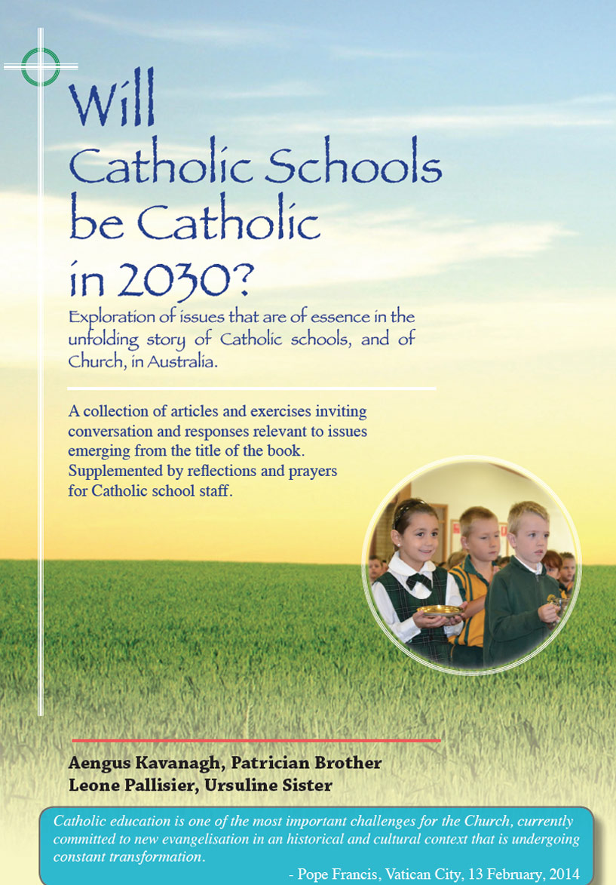
Beyond a profession?
Teaching and
leading
in a
Catholic school
107-110

Slide 2
Teaching and leading in a Catholic school
Themes
Beyond a profession? Pages 107-110

Slide 3
At no time in the history of education in Australia has there been such a detailed and comprehensive articulation of standards for teachers and school leaders.
This is a praiseworthy advancement with much potential to raise standards in teaching and learning, and simultaneously, to raise the profile of teachers and principals in a society.
A main driving force in this development is the research evidence that the quality of teaching and leadership within the school are the main determinants of the school’s effectiveness.

Slide 4
A possible criticism of the AITSL standards however is that their main focus is on the teacher as a functionary with an emphasis on knowledge and competency skills. This parallels a widespread trend to trump the science of teaching ahead of the art of teaching.

Slide 5
The art of teaching strongly accentuates a primacy for the human and relational dimensions at the heart of the teaching/learning process. In turn, the art of teaching is strongly linked to the kind of person the teacher is, the human and spiritual qualities the person brings to the role. Invariably, these qualities will be at the fore in the minds of people who look back in gratitude and affection on teachers who have most touched their lives in positive ways.

Slide 6
‘But seldom if ever do we ask the ‘who’ question - who is the self that teaches ? How does the quality of my self-hood form – or deform - the way I relate to my students’ (Parker Palmer – ‘Courage to Teach’)
The dominant theme in Parker Palmer’s program is the contention that the real authority of the teacher resides in the teacher’s inner life, the soul.

Slide 7
In a context of teaching in a Catholic school especially, these considerations impinge on the dance between teaching as a profession and teaching as a vocation.
Author Gloria Durka makes this distinction: ‘Professions are recognised by outside criteria. People can conduct themselves professionally but may not consider their work a calling. Those who regard teaching as a vocation derive their identity from an inner motivation that allows them to shape their roles rather than merely occupy them.’
Teaching in a Catholic school that exists as part of God’ mission for the church in the world, is derived from the mission of Jesus. This understanding lends itself easily to the notion of teaching as a vocation.

Slide 8
Teachers in Catholic schools are collaborators with local church and parents in efforts to integrate life, culture, and faith.
In a former era, generations of young men and women in Australia joined religious congregations that enabled them to live out their vocations as teachers and leaders in Catholic schools. Present generations of teachers and leaders in Catholic schools of the 21st century continue the work of their predecessors, elevating and sanctifying the lives of young people, ‘growing saints’. Surely the stuff of ‘vocation’? A matter of choice?

Slide 9
Teaching and leading in a Catholic school
Reflection and Discussion
Beyond a profession? Pages 107-110

Slide 10
Think In the roles of teaching and leading in a Catholic school, what mindsets underlie the following terms and where do I see myself across these categories ?
Job
Career
Profession
Vocation
In my present role, what are some key activities and experiences that carry personal meaning for me giving me a feeling that I really do make a positive difference in my school or Office?

Slide 11
Would I be pleased to have children of my own teaching in a Catholic school? If so, why?
What are some school/system policies and practices that help to deepen commitment to teaching? Are there further initiatives we could take to strengthen our understanding and appreciation of the art of teaching?
What does it mean ‘to teach/lead with soul’?

