Slide 1
Guest articles
Will Catholic
Schools be
Catholic
in 2030?
9-17

Slide 2
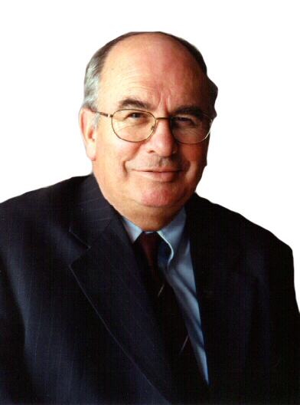
Will Catholic Schools be Catholic in 2030?
Themes
Pages 9-17

Slide 3
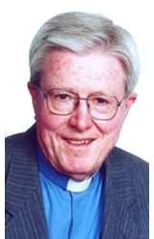
‘The whole of education ought to be an opening up to new persons, objects, activities and ideas that growing people can love. If it does not produce a profound sense of meaning in life through an abundance of love, education has failed.’
Bishop Geoff Robinson
13 April 2015

Slide 4
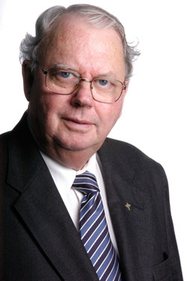
‘In an increasingly secular society, successful Catholic schools will be unambiguously Catholic, led by well prepared and committed lay women and men who are passionate about the Gospel of Jesus and anxious to provide a high quality education in a Catholic context.’
Brother Kelvin Canavan
13 April 2015

Slide 5
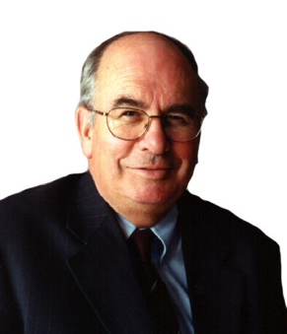
‘Of more concern is the risk of building a
culture of superficiality. Simply having the tools to search the Internet which builds our information base at an exponential rate does not build knowledge, values and wisdom.
The Catholic school tradition draws upon a wealth of culture and narrative which
values the past as well as the instant,
immediate present.
As a harbinger of hope, I expect the 2030 Catholic school will atune its graduates to being socio critical, to addressing social
transformation in our world.’
Br Tony Whelan
13 April 2015

Slide 6
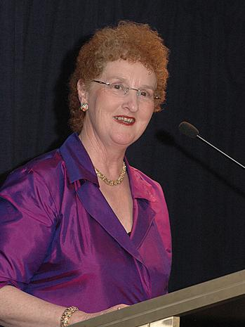
‘The critical lever in building future Catholic schools that are vibrantly Catholic is a commitment to the ongoing professional learning of Catholic school teachers and leaders in the rich heritage of our faith and in their own maturing faith formation and spirituality.
This requires a significant ongoing investment in high quality professional development and formation. Will church and educational system leaders be willing to make that investment now to make Catholic schools more Catholic in 2030?’
Dr Anne Benjamin
13 April 2015

Slide 7
Will Catholic Schools be Catholic in 2030?
Sharing some thoughts
Pages 9-17

Slide 8
Read through the selected Themes. Pick one quote that appeals to you and/or challenges you. In twos or threes, share your thoughts and feelings.
In the four articles, pages 9-17, name some common themes and/or single perspectives
Discuss any other issues arising from these articles that have personal or collective implications?
11 April 2015

