Slide 1
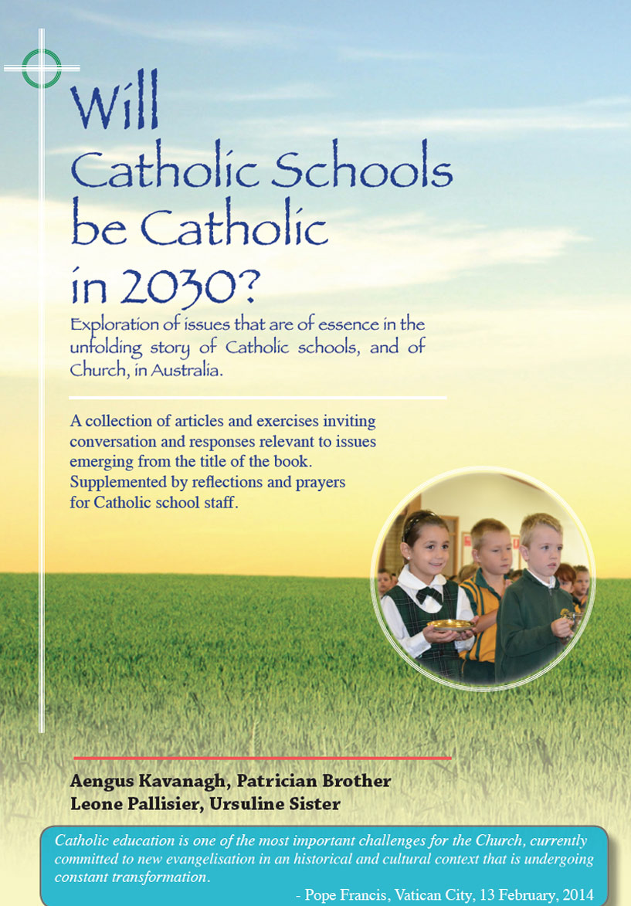
Catholic School
Culture
91-94
Some different scenarios

Slide 2
Catholic School Culture
Themes
Some different scenarios Pages 91-94

Slide 3
Pages 91 & 92 give ‘good culture’/’bad culture’ scenarios supposedly applying in two primary schools. These outlines, or modifications of these, could well provide a staff development day strategy to focus on attitudes and practices which impact significantly on the general culture and on the Catholic culture of the school.

Slide 4
‘Why do parents choose a Catholic school education for their children?’ There is no single answer to this question, but it is probable that the perceived culture of a Catholic school figures prominently among the reasons why many parents choose to send their children to Catholic schools..

Slide 5
Many parents and staff would name the following as positive elements of that culture: good discipline, pleasing school image including student uniforms, good academic and sporting achievement, good pastoral care practice.
Sure enough these are all desirable qualities but a majority of good State schools would rightly lay claim to similar qualities.

Slide 6
The third scenario - Valley Park Primary school, invites Catholic school leaders and teachers to become more intentional in naming the factors that make life in a Catholic school different. In so naming, there is the further invitation to explore and to review the deeper sources of meaning that underlie the religious and spiritual dimension of the school.

Slide 7
Pages 93 & 94 - ‘Snapshot: Expressions and Builders of Catholic Culture In The School’, offers an exercise to engage staff in identifying commonly accepted elements of Catholic school culture as they apply in the school now.
Such an exercise has potential to affirm present good policy and practice while identifying areas in possible need of development or renewal. The exercise process can be helpful in strengthening a union of hearts and minds around things that matter most.

Slide 8
Catholic School Culture
Reflection and Discussion
Some different scenarios Pages 91-94

Slide 9
What are the main points of difference as portrayed for St David’s and St Barbara’s? What are possible causes and how might the St David’s culture be ‘turned around’?
After his term at St Mary’s Primary, what differences may John Rogers sense and what possible underlying influences give rise to such differences?

Slide 10
In the SNAPSHOT exercise (page 94) (i) Any important issues missing? ii) Any items you would express differently?
In 3’s or 4’s, have a conversation about different perceptions registered in your responses. Any issues arising?
PLENARY.
Name the affirmations and take satisfaction.
Name issues requiring attention and make provision for follow-up.

